Slide 1
Ggplot2 and interactive graphics with R
Christophe Ladroue
SECTION 02
VIDEO 02
Drawing paths
www.PacktPub.com

Slide 2
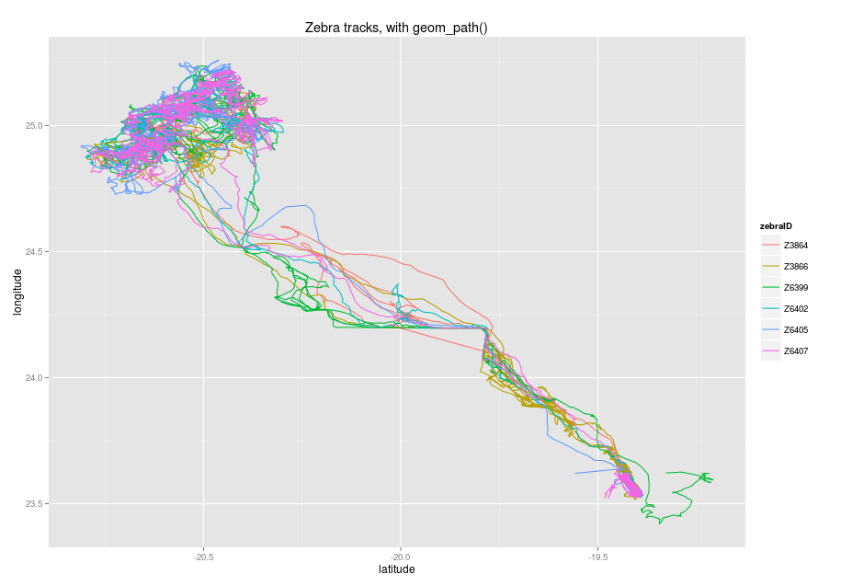
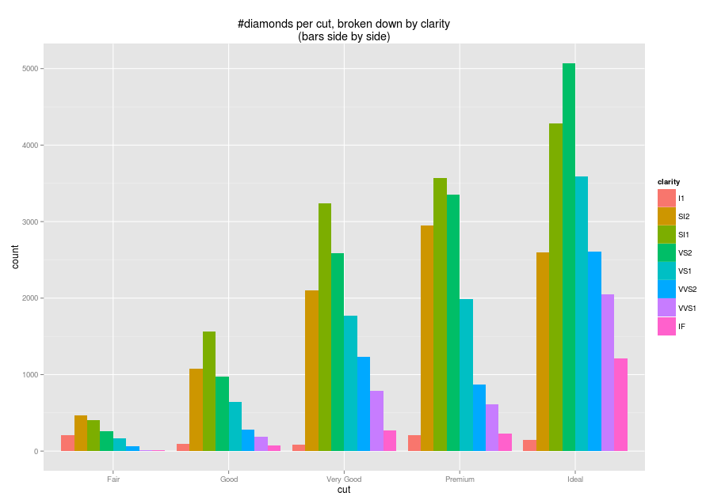
In this video we took a look at
how to use geom_path() to connect points together in the order they appear in the data frame.
how to use the colour aesthetic to visually differentiate different paths and automatically produce a legend.
Next: bar charts

